Slide 1

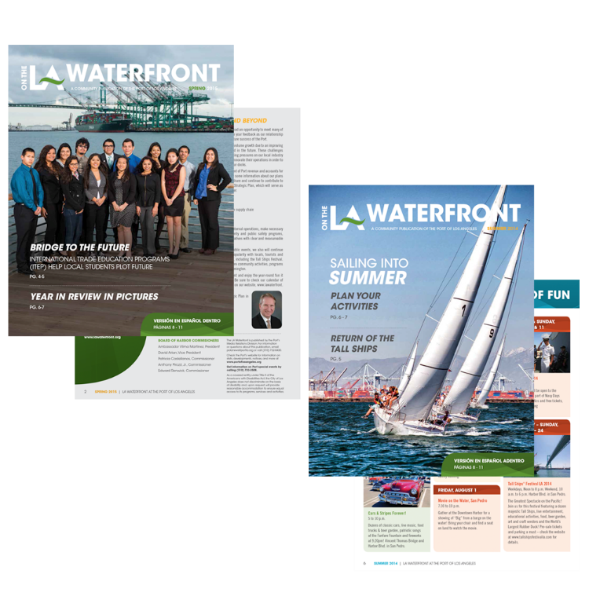
Port of
Los Angeles
LA Waterfront Magazine
Periodicals

